Slide 1

IPL AUCTION PREDICTION
NAME:PAVAN CHAKRASALI
SRN: PES1PG22CA139
PROJECT GUIDE: Prof SANTOSH KATTI
Department of Computer Applications

Slide 2
PROJECT TOPIC
IPL AUCTION PREDICTION USING MACHINE LEARNING
PES1PG22CA139,PAVAN CHAKRASALI,SECTION-C
Department of Computer Applications

Slide 3
IPL AUCTION PREDICTION USING MACHINE LEARNING
ABSTRACT
In this work, we have applied machine learning-based algorithms that predicts the cost at which a player can be sold in the Indian Premier League Auction. We estimated the players' selling price using their past performance parameters like runs, balls, innings, wickets and matches played.
Tests were carried out in various machine learning models like Decision Tree Regressor, K-Nearest Neighbors (KNN), Linear Regression, Random Forest Regressor and Support Vector Regression (SVR).
Among these catboost and Linear Regression gave best results for predicting batsman and bowlers respectively helping auctioneers make quick decisions. We have also considered inflation factor and mapping of the same to the budget during the training of the model.
`

Slide 4
IPL AUCTION PREDICTION USING MACHINE LEARNING
PROBLEM SCENARIO
In the time of IPL everyone tries to predict the value of the players
viewers cannot find the price for how much players can get
With the help of this model viewers can also get to know about predicted price for the players based on their performance in the tournament.
It gives more accuracy about the players how much they deserve to get paid.

Slide 5
IPL AUCTION PREDICTION USING MACHINE LEARNING
PURPOSE
The purpose of undertaking IPL auction prediction using machine learning is to revolutionize the decisionmaking process by using of advanced analytics and machine learning algorithms, the aim is to provide stakeholders—franchise owners, coaches, and fans—with accurate ,This initiative seeks to enhance the strategic planning and resource allocation of IPL franchises, optimizing their chances of assembling competitive and balanced teams while navigating the unpredictable dynamics of the auction.
Team Composition: Identifying optimal team combinations that complement each other's strengths. This extends to predicting the impact of a new player on the overall team dynamic and performance.

Slide 6
IPL AUCTION PREDICTION USING MACHINE LEARNING
SCOPE
Player Valuation: The primary focus is on predicting the fair market value of players based on historical performances, statistics, playing conditions, and various contextual factors.

Slide 7
IPL AUCTION PREDICTION USING MACHINE LEARNING
DOMAIN SURVEY
DOMAIN
The application focuses on IPL auction prediction
The system implemented using machine learning

Slide 8
IPL AUCTION PREDICTION USING MACHINE LEARNING
DETAILED LITERATURE SURVEY
1. Prediction of Player Price in IPL Auction Using Machine Learning Regression Algorithms
Authors: Jhansi Rani, A Kulkarni, A V Kamath, A Menon
Published in: 2020 IEEE International Conference on Electronics, Computing and Communication Technologies (CONECCT)
Year: 02-04 July 2020
summery: This paper explores the use of various machine learning regression algorithms to predict the selling price of players in the IPL auction. Features like runs, balls, innings, wickets, and matches played are used to train the models. Support Vector Regression (SVR) and Linear Regression were found to be the most effective algorithms for predicting batsman and bowler prices respectively.
Reference:-https://ieeexplore.ieee.org/document/9198668

Slide 9
IPL AUCTION PREDICTION USING MACHINE LEARNING
DETAILED LITERATURE SURVEY
2. IPL Players Cost Pay Prediction using Machine Learning Techniques
Author: Nagaraj P, Muneeswaran V, Raja M, M C Prabhu, B Meghana
Published in: 2023 Second International Conference on Augmented Intelligence and Sustainable Systems (ICAISS)
Year: 23 August 2023
summery : The accuracy of an IPL player cost prediction system in anticipating player auction prices is a measure of its success. The system's correctness can be measured using various metrics such as mean absolute error (MAE), mean squared error (MSE), and root mean square error (RMSE). These measures show how well the forecasted prices reflect the actual auction prices.
Reference:- https://ieeexplore.ieee.org/document/10250755

Slide 10
IPL AUCTION PREDICTION USING MACHINE LEARNING
DETAILED LITERATURE SURVEY
3. Cricket Players Performance Prediction and Evaluation Using Machine Learning Algorithms
Authors:M Sumathi; S Prabu; M Rajkamal
Published in: 2023 International Conference on Networking and Communications (ICNWC)
Year: 05 April 2023
summery : In this paper, different ML techniques are evaluated to predict the performance of a specific player. Linear regression, K-Means, and random forest models are used to predict the performance of a male cricket player. The performance of cricket players are predicted and regressed with linear lines using linear regression to select the relevant attribute for performance analysis.
Reference:- https://ieeexplore.ieee.org/document/10127503

Slide 11
IPL AUCTION PREDICTION USING MACHINE LEARNING
DETAILED LITERATURE SURVEY
4. Predicting Results of Indian Premier League T-20 Matches using Machine Learning
Authors: Shilpi Agrawal; Suraj Pal Singh; Jayash Kumar Sharma
Published in: 2018 8th International Conference on Communication Systems and Network Technologies (CSNT)
Year: 24 November 2018
summery : In this work, historical data has been collected from real IPL cricket matches and useful features have been extracted after pre-processing of data. Further, suitable data is converted to a numeric form and scale it on three parameters win, loss, and tie. This data is trained and classified with three classifier SVM, CTree and Naïve Bayes using R Tool.
Reference:- https://ieeexplore.ieee.org/document/8820235

Slide 12
IPL AUCTION PREDICTION USING MACHINE LEARNING
DETAILED LITERATURE SURVEY
5. Selection of Players and Team for an Indian Premier League Cricket Match Using Ensembles of Classifiers
Authors: P J Rani, Aditya V Kamath, A Menon
Published in: 2020 IEEE International Conference on Electronics, Computing and Communication Technologies (CONECCT)
Year: 02 July 2020
summery : This paper explores the potential of Support Vector Machines and Random Forests for predicting player prices in the IPL auction. It analyzes both traditional performance metrics and advanced features like form index and player impact score. The authors highlight the importance of realtime data integration and model adaptation to address the dynamic nature of the auction environment.
Reference:-https://ieeexplore.ieee.org/document/9198371

Slide 13
IPL AUCTION PREDICTION USING MACHINE LEARNING
SOFTWARE REQUIREMENTS
Programming: Python 3.12.0
Machine learning : NumPy, Pandas, Seaborn, Pycaret a for efficient data manipulation and model evaluation.
Back end framework: Flask 3.11
Front end development: html 5, CSS3, JavaScriptES8
HARDWARE REQUIREMENTS
RAM : 8 GB and above.
Processor : Intel Core i7
Storage : 1 TB HDD
Operating system : Windows 10

Slide 14
IPL AUCTION PREDICTION USING MACHINE LEARNING
FUNCTIONALITIES
Team Management
SEARCH PLAYER
PREDICT VALUE
ADD/DISCARD PLAYER
CREATE TEAM
VIEW PURSE
VIEW TEAM

Slide 15
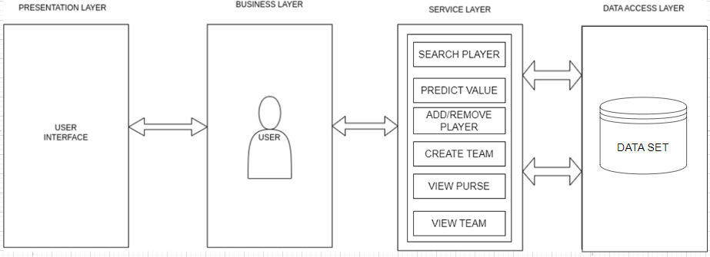
IPL AUCTION PREDICTION USING MACHINE LEARNING
ARCHITECTURE DIAGRAM

Slide 16
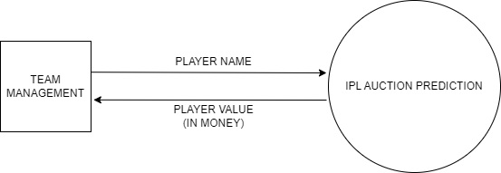
IPL AUCTION PREDICTION USING MACHINE LEARNING
CONTEXT DIAGRAM

Slide 17
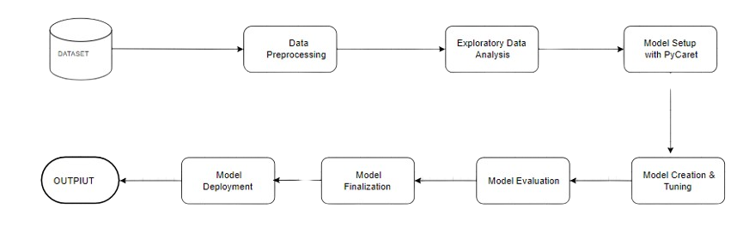
IPL AUCTION PREDICTION USING MACHINE LEARNING
PROCESS FLOW

Slide 18
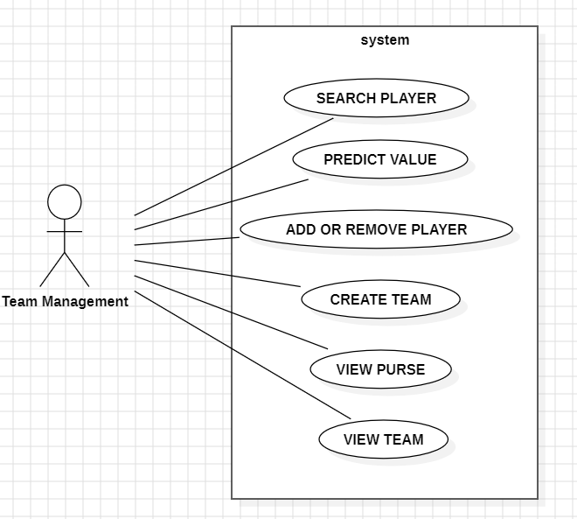
IPL AUCTION PREDICTION USING MACHINE LEARNING
USE CASE DIAGRAM

Slide 19
IPL AUCTION PREDICTION USING MACHINE LEARNING
APPLICATION IN REAL WORLD
Develop a user-friendly interface that allows team owners and analysts to interact with the machine learning predictions.
Provide strategic recommendations to team owners and analysts based on predicted player performances, bid prices, and team requirements.

Slide 20
IPL AUCTION PREDICTION USING MACHINE LEARNING
PSEUDO CODE
Run the Application
User Interface appears, then pass the players statistics
3.Then click on predict
Preprocess the statistics for the catboost model.
Make the prediction using catboost model and retrive the predicted value.
4.You can add the player to the team by clicking on the add or you can discard the player
5.All the players can be viewed at view team

Slide 21
IPL AUCTION PREDICTION USING MACHINE LEARNING
TEST CASES
Test Case ID | Step Details | Expected Action | Actual Action | Pass/Fail
TC 01 | Checking for the values In range | Alerts should be displayed if any value is out of the acceptable range. | Alerts is displayed | Pass
TC 02 | Adding a Player above Player Limit | A flag message "Player count limit reached. Cannot add more players." Should be displayed. | Flag message is displayed | Pass
TC 03 | Add a new player when the budget is insufficient | A flag message "Insufficient budget to add this player.” Should be displayed | Flag message is displayed | Pass
TC 04 | Add a player who is already in the team | A flag message "{name} already exists!" should be displayed. | Flag message is displayed | Pass

Slide 22
IPL AUCTION PREDICTION USING MACHINE LEARNING
IDENTIFIED JOURNAL
1. Machine Learning in Communications and Networking, IEEE Transactions on
(35 Weeks)
Access: Open access
Article Submission website: https://ieee.atyponrex.com/journal/mlcn
2. Neural Networks and Learning Systems, IEEE Transactions on(53 Weeks)
Access: Open access
Article Submission website:http://mc.manuscriptcentral.com/tnnls
3. Artificial Intelligence, IEEE Transactions on (24.4 Weeks)
Access: Open access
Article Submission website: https://ieee.atyponrex.com/journal/tai-ieee

Slide 23
IPL AUCTION PREDICTION USING MACHINE LEARNING
IDENTIFIED CONFERENCE
1. 2024 Second International Conference on Networks, Multimedia and Information Technology (NMITCON)
Abstract Submission Deadline:30 May 2024
Notification of Acceptance Date:30 Jun 2024
Accepted Paper Submission Deadline:10 Jul 2024
Conference Dates: 09-10 Aug 2024
Location: Bengaluru, India
2. 2024 7th International Conference on Circuit Power and Computing Technologies (ICCPCT)
Abstract Submission Deadline:31 May 2024
Notification of Acceptance Date:12 Jul 2024
Accepted Paper Submission Deadline:26 Jul 2024
Conference Dates: 08-09 Aug 2024
Location: Kollam, India

Slide 24
IPL AUCTION PREDICTION USING MACHINE LEARNING
IDENTIFIED CONFERENCE
3. 2024 IEEE 3rd World Conference on Applied Intelligence and Computing (AIC)
Abstract Submission Deadline:30 Apr 2024
Notification of Acceptance Date:20 Jun 2024
Accepted Paper Submission Deadline:25 Jun 2024
Conference Dates: 27-28 Jul 2024
Location: Gwalior, India
4. 2024 International Conference on Recent Advances in Science and Engineering Technology (ICRASET)
Abstract Submission Deadline:26 Jul 2024
Notification of Acceptance Date:30 Sep 2024
Accepted Paper Submission Deadline:21 Oct 2024
Conference Dates: 21-22 Nov 2024
Location: Mandya, India

Slide 25
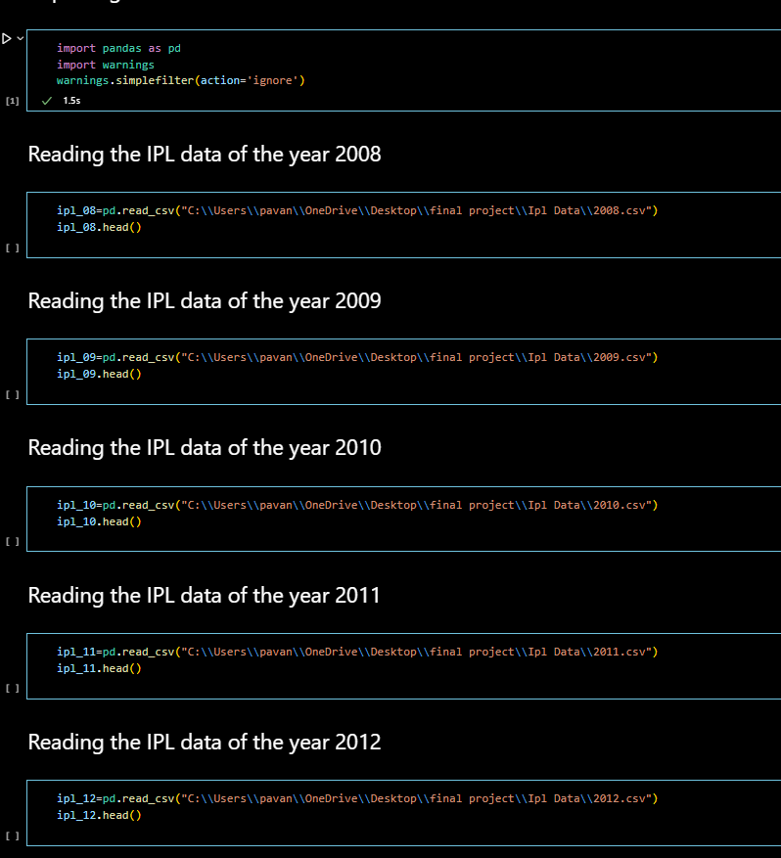
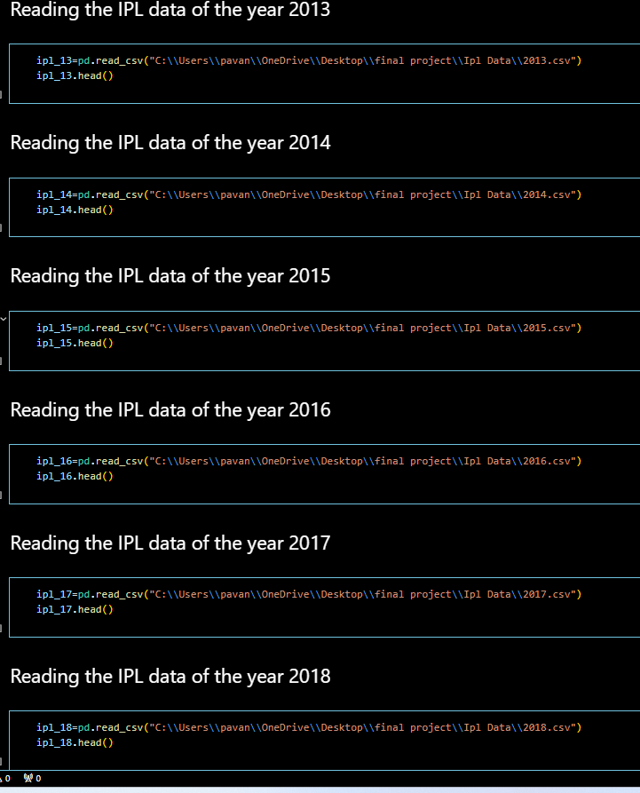
IPL AUCTION PREDICTION USING MACHINE LEARNING
IMPLIMENTATION

Slide 26
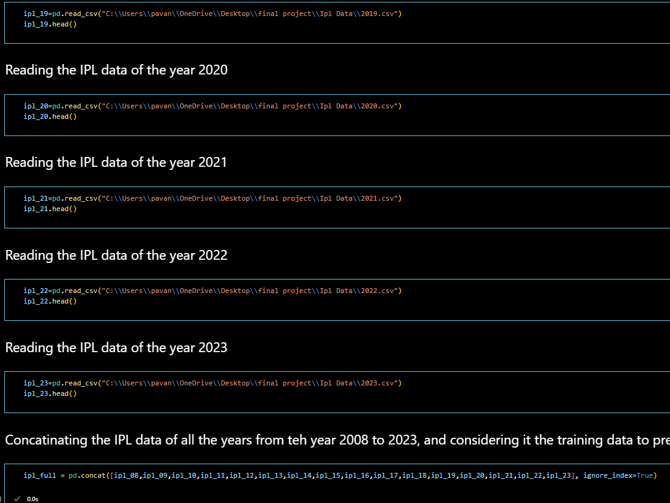
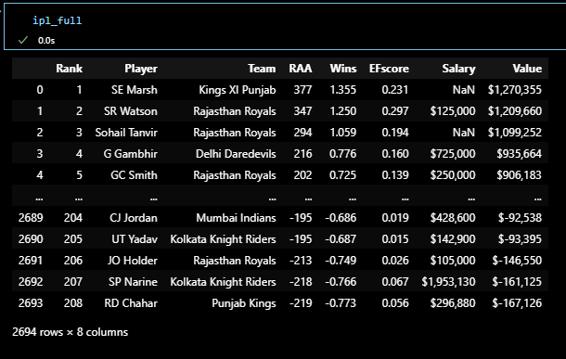
IPL AUCTION PREDICTION USING MACHINE LEARNING
IMPLIMENTATION

Slide 27
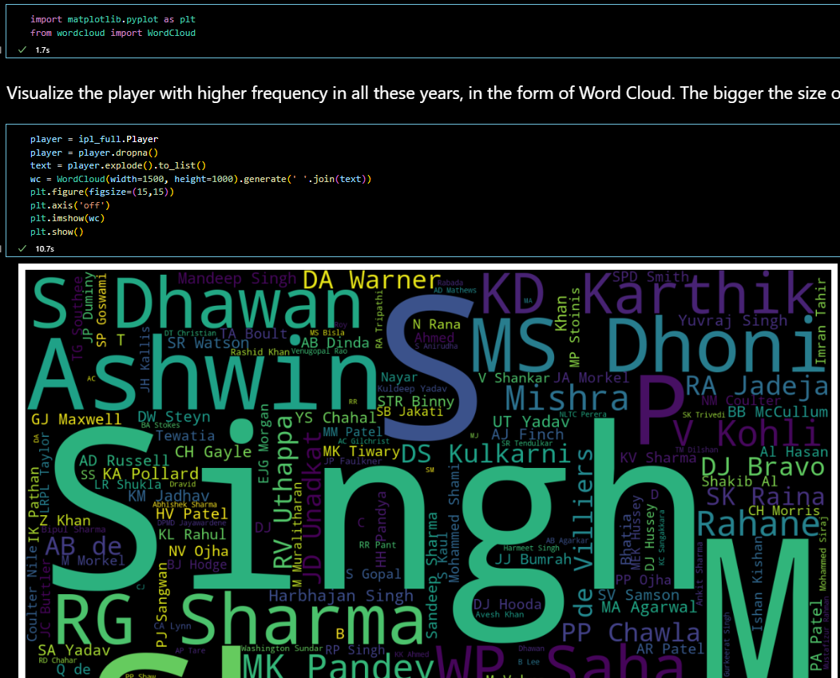
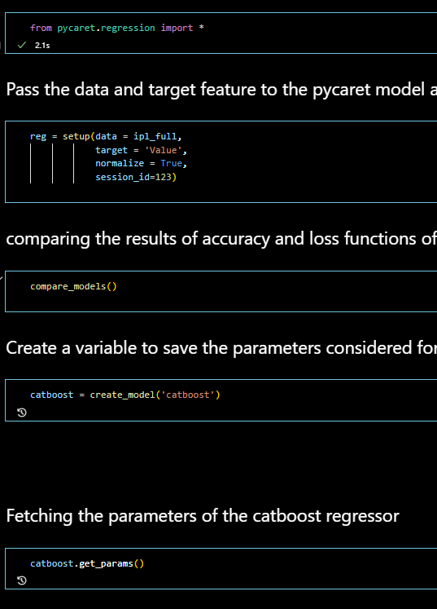
IPL AUCTION PREDICTION USING MACHINE LEARNING
IMPLIMENTATION

Slide 28
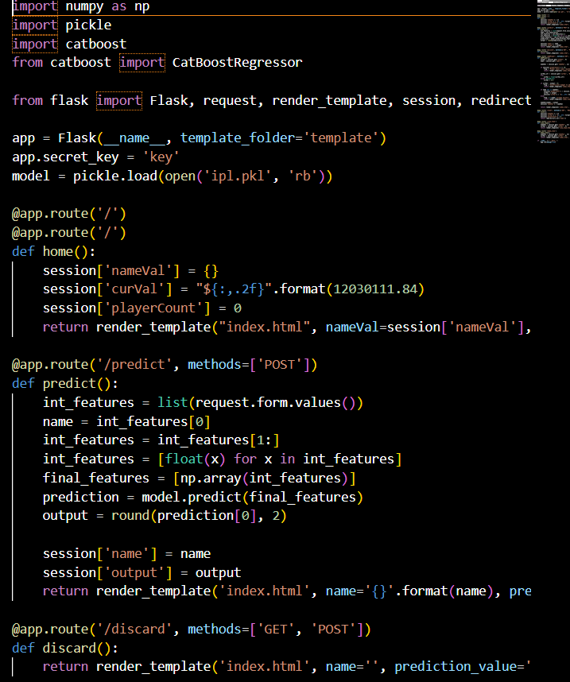
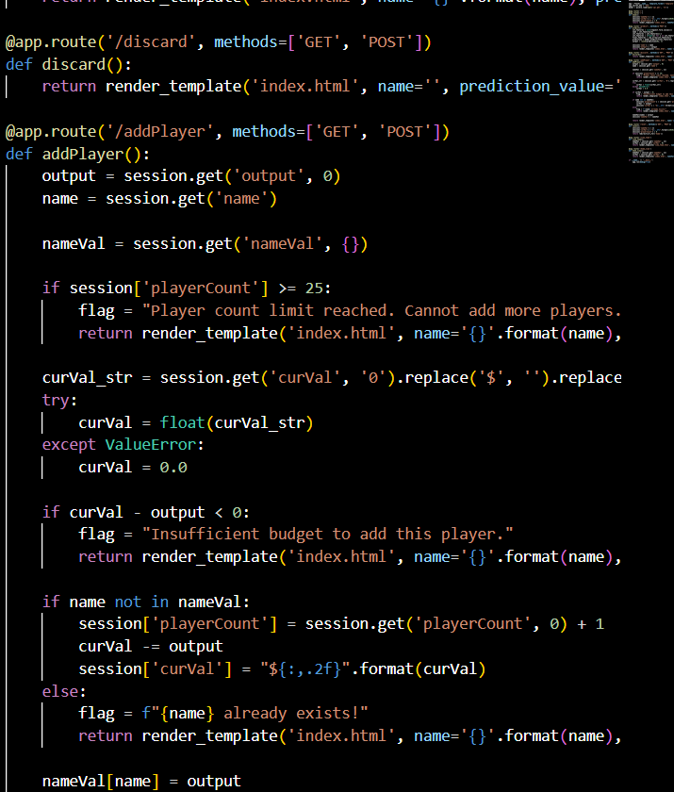
IPL AUCTION PREDICTION USING MACHINE LEARNING
IMPLIMENTATION

Slide 29
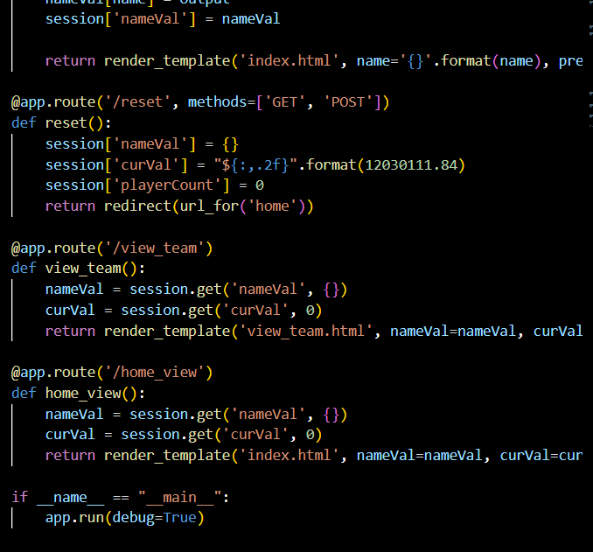
IPL AUCTION PREDICTION USING MACHINE LEARNING
IMPLIMENTATION

Slide 30
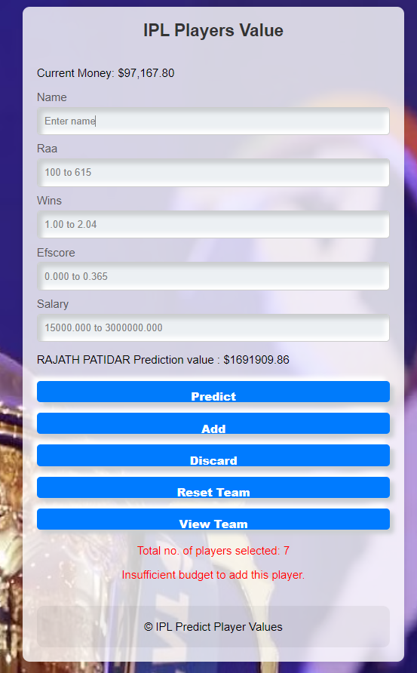
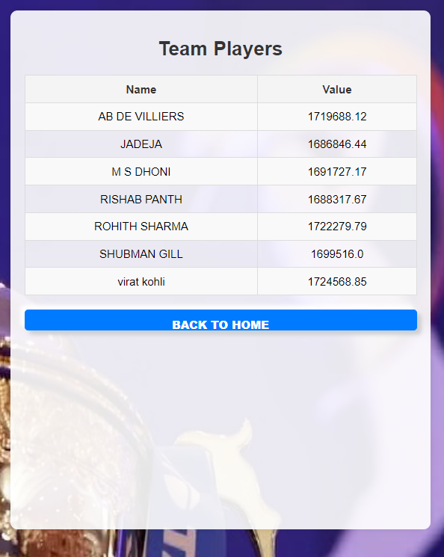
IPL AUCTION PREDICTION USING MACHINE LEARNING

Slide 31
IPL AUCTION PREDICTION USING MACHINE LEARNING
CONCLUSION
A machine is evolved and evaluated numerous device learning fashions to are expecting the promoting fees of gamers in the Indian Premier League (IPL) auction Our evaluation encompassed quite a few algorithms, inclusive of Decision Tree Regressor, K-Nearest Neighbors (KNN), Linear Regression, Random Forest Regressor, and Catboost. Among those, Catboost and Linear Regression emerged as the best models for predicting the public sale expenses of batsmen and bowlers, respectively. . Overall, our technique demonstrates the capacity of machine getting to know in enhancing the efficiency and accuracy of participant valuation in sports activities auctions.

Slide 32
IPL AUCTION PREDICTION USING MACHINE LEARNING
FUTURE ENHANCEMENTS
Advanced Statistics: Incorporate advanced cricket metrics including strike rate, financial system fee, and participant health facts.
Player Form and Fitness: Add latest shape, health reviews to higher expect a player's future performance.
Market Sentiment Analysis: Incorporate market sentiment analysis the usage of social media and information to seize the public perception and call for for gamers.
Sponsor Influence: Analyze the impact of sponsorship deals and endorsements on participant price.
Generalization: Adapt and generalize the model to are expecting participant auction prices in other sports activities leagues (NBA, NFL) via incorporating recreation-unique overall performance metrics.

Slide 33
IPL AUCTION PREDICTION USING MACHINE LEARNING
REFERENCES
Literature survey
Paper 1: https://ieeexplore.ieee.org/document/9198668
Paper 2: https://ieeexplore.ieee.org/document/10250755
Paper 3: https://ieeexplore.ieee.org/document/10127503
Paper 4: https://ieeexplore.ieee.org/document/8820235
Paper 5: https://ieeexplore.ieee.org/document/9198371

Slide 34
THANK YOU
PAVAN CHAKRASALI
Department of Computer Applications

